Slide 1
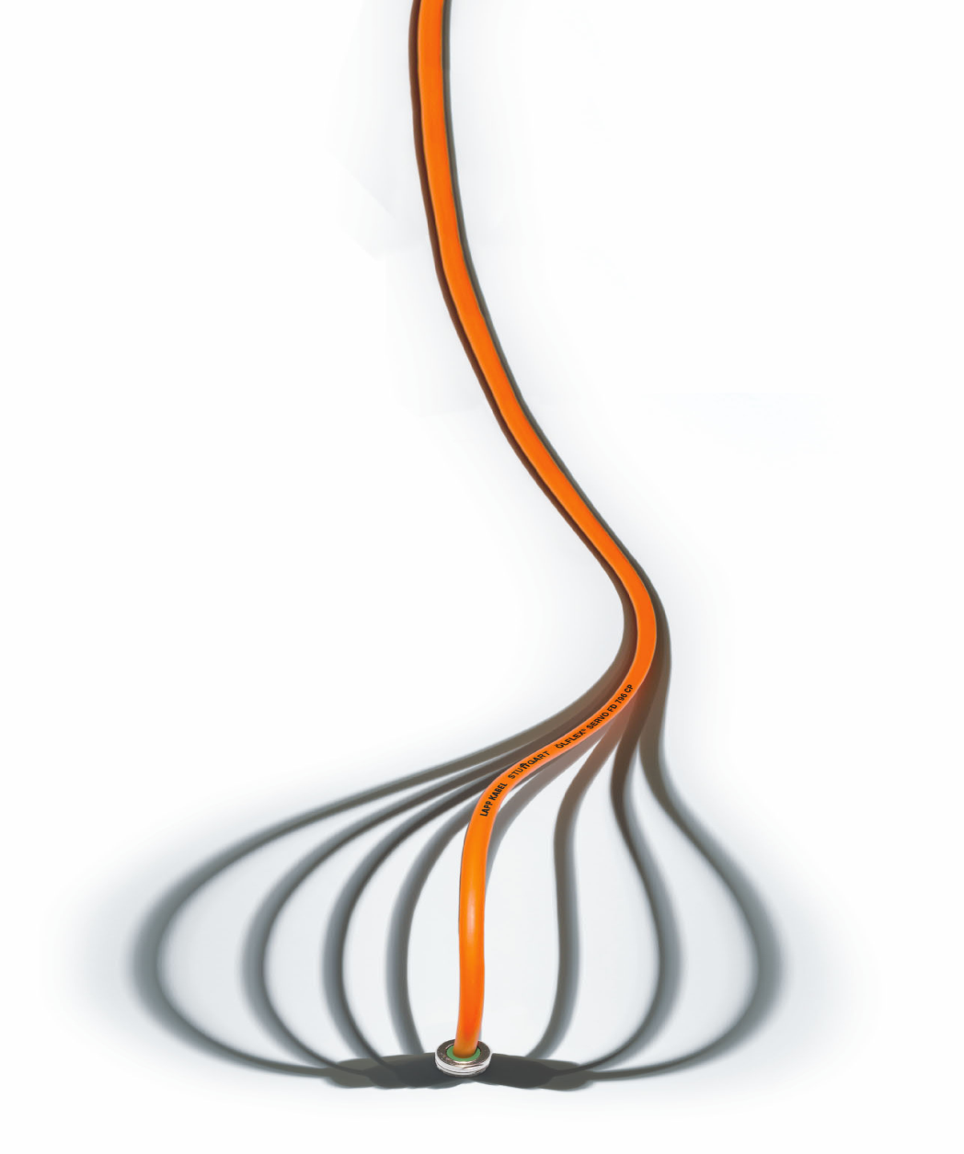

Welcome
To
A seminar on
“Total Solution in
Electrical Connectivity”

Slide 2

About Lapp
Lapp Group
Global
Asia Pacific
Lapp India
West

Slide 3
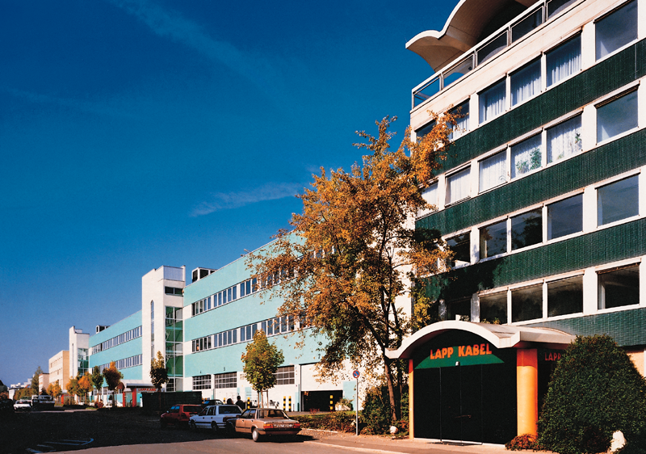
Lapp Group
Founded in 1957, headquartered in Stuttgart, Germany
8 Brands - 40,000+ products
15 production sites - 41 sales companies
100 national partners worldwide
3000+ employees
Founded in 1957, by Mr Oskar Lapp
Headquartered in Stuttgart, Germany

Slide 4
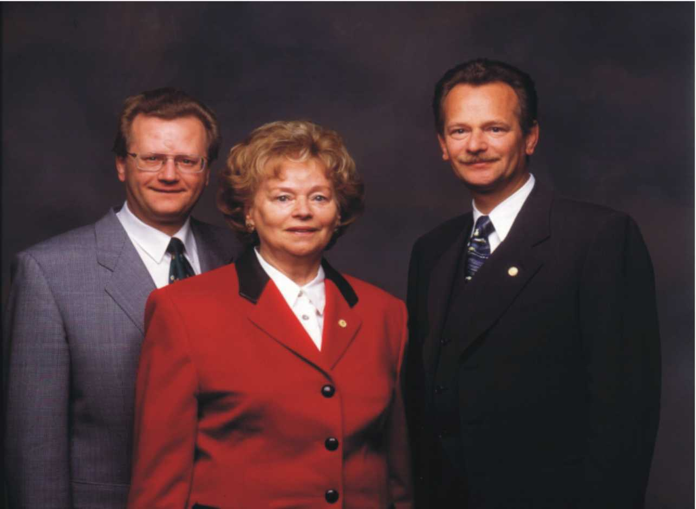
Lapp Family
Founded in 1957, headquartered in Stuttgart, Germany
8 Brands - 40,000+ products
15 production sites - 41 sales companies
100 national partners worldwide
3000+ employees

Slide 5

Lapp Group
8 Brands - 40,000+ products
15 production sites - 41 sales companies
100 national partners worldwide
3000+ employees

Slide 6
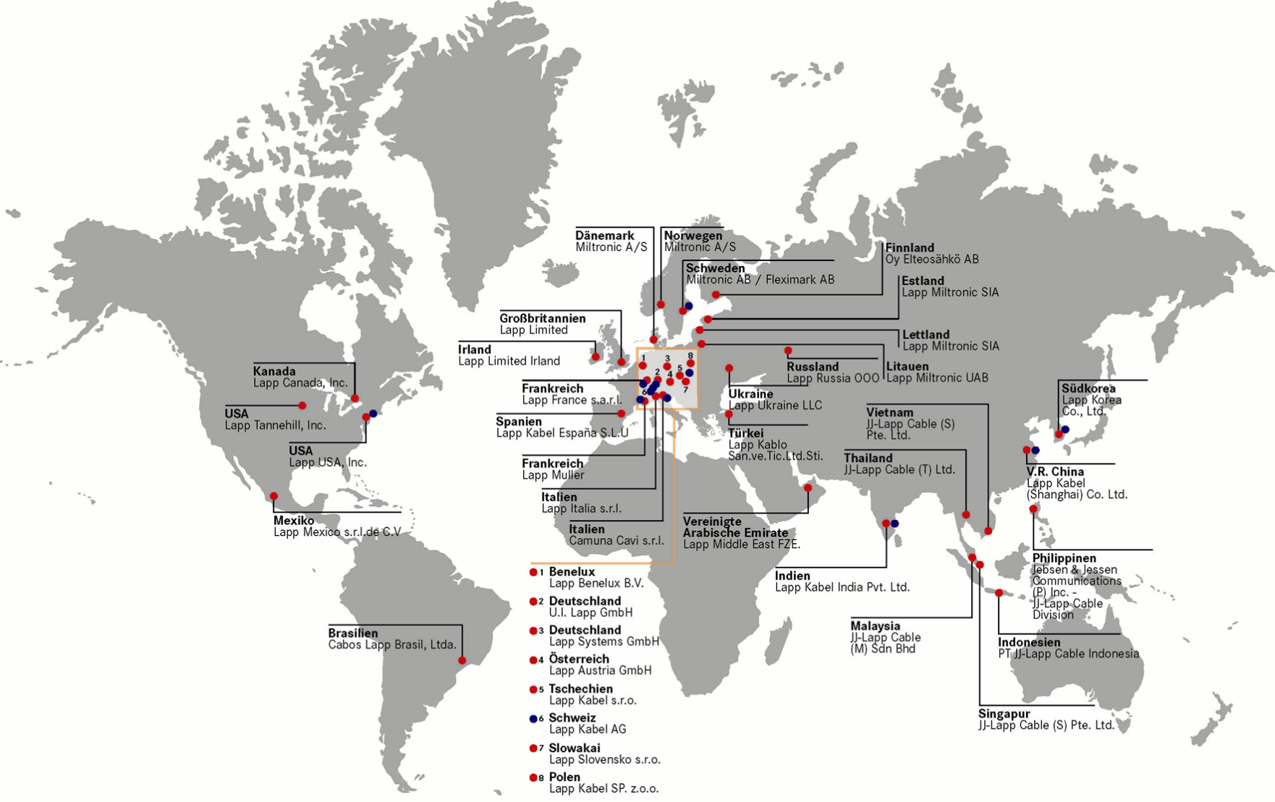
Global Presence

Slide 7
Global Presence
EUROPE
AMERICAS
AFRICA
ASIA PACIFIC
@ 20% of Group Sales

Slide 8
Asia Pacific Presence
CUSTOMERS
&
PARTNERS
LAPP HOLDING ASIA
LAPP INDIA
LLOG
JJ LAPP
LAPP KOREA
LAPP CHINA
20% of the global turnover
@1000 employee
5 future production sites
LAPP INDIA
2nd largest in Lapp Group after Germany
Focus of Group’s investment
Potential to be as large as Lapp Germany
SINGAPORE
MALAYSIA
INDONESIA
THAILAND
PHILIPPINES
VIETNAM
REST OF ASEAN
JAPAN
TAIWAN
AUSTRALIA
NEW ZEALAND

Slide 9
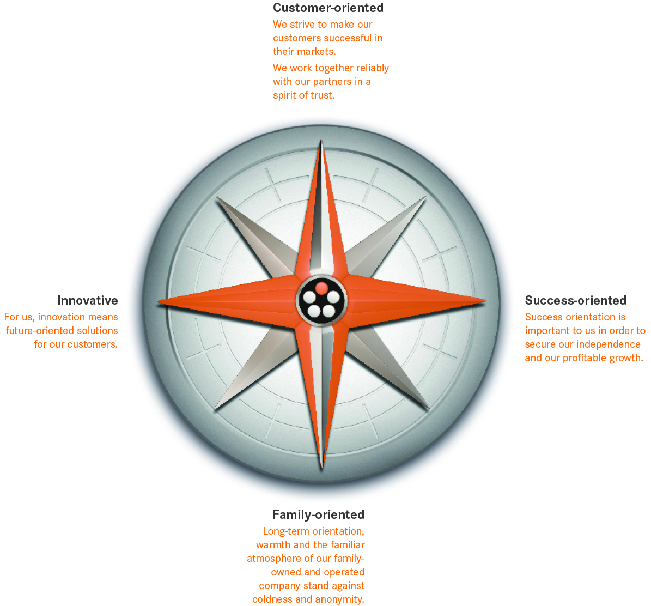


Guiding Principles
About LAPP
LAPP India
Quality
Differentiators
Brands
Solutions
Contact

Slide 10
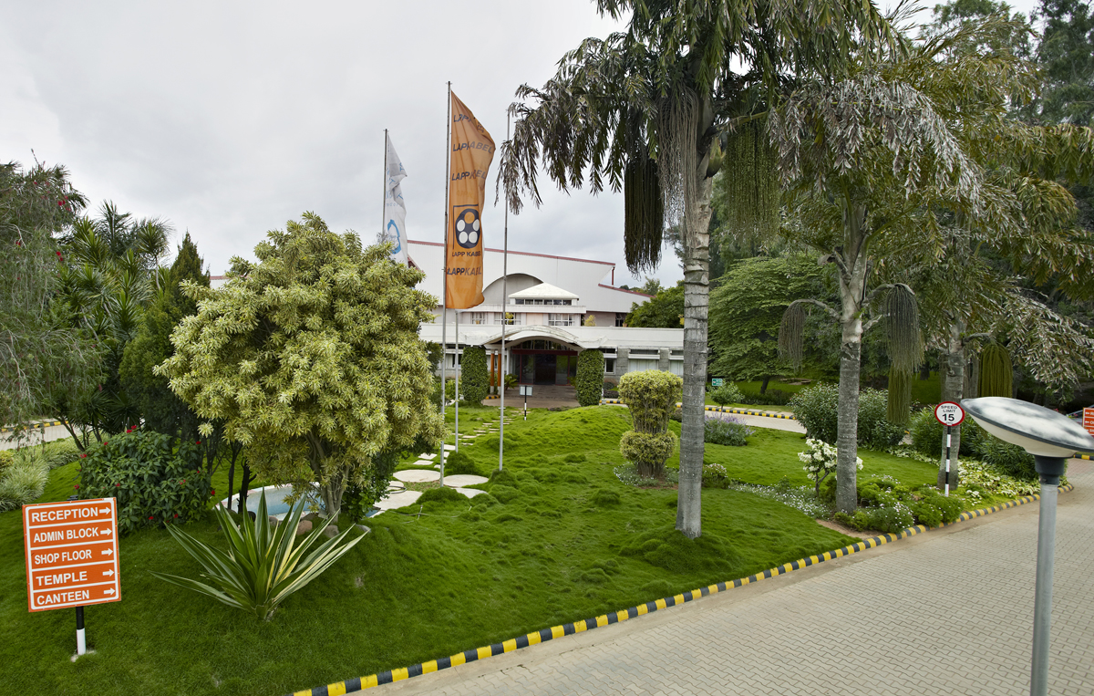
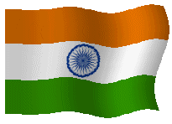
Lapp India
Overview
Journey
Network
Diverse Verticals
Clients

Slide 11
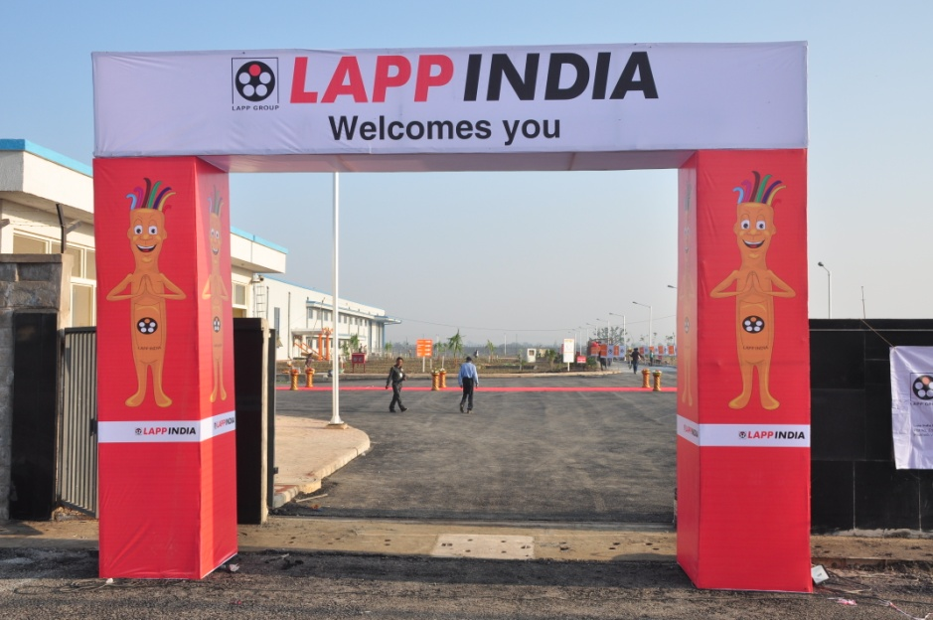
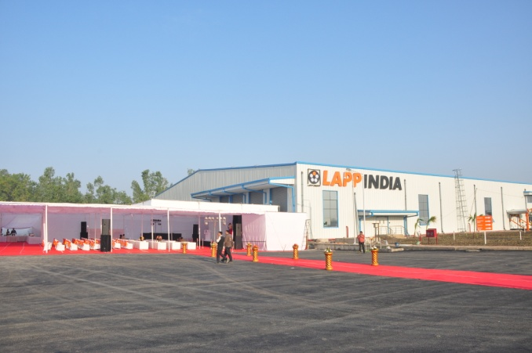
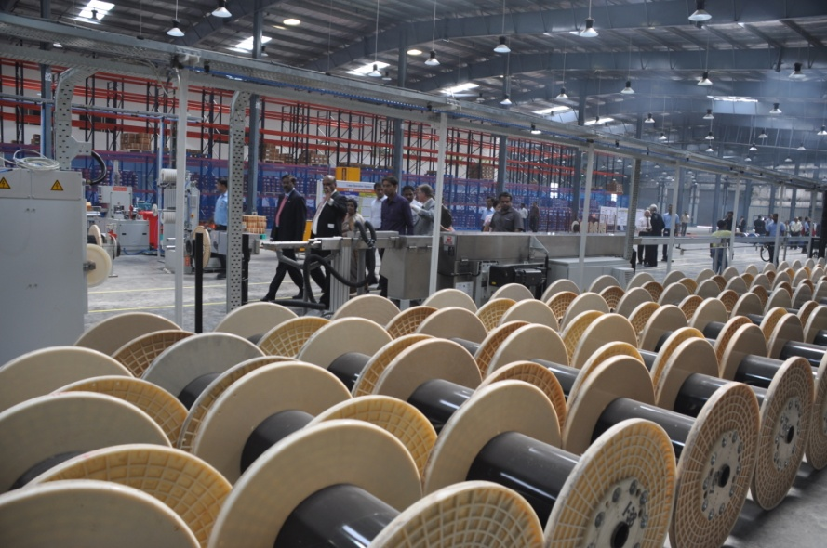
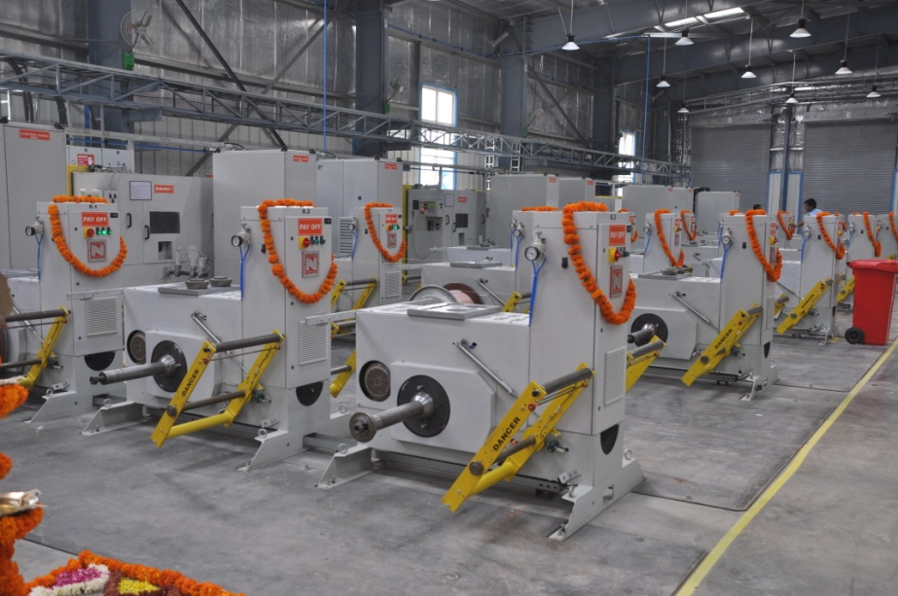
Bhopal factory inaugurated November 08, 2012

Slide 12
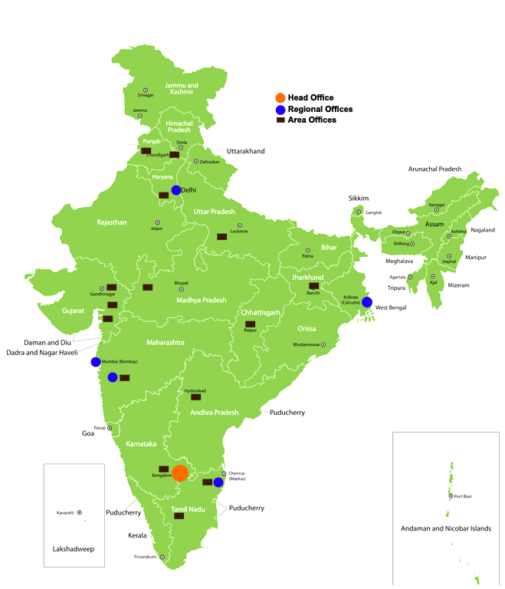
Overview
Employees: 250+
4 regional offices in major cities
25 sales offices across the country
100+ Strong dealer network
Warehouses near Delhi, Bangalore, & Chennai
Expanded production & harnessing facilities
Large local team for application support

Slide 13
Sales Network (West)
Accounts to 30% of Lapp India turnover
Responsible for Maharashtra, Gujarat, M.P., Chhattisgarh, Goa, Daman & Diu
Consists of 17 sales personnel
Regional office at Mumbai
3 branch offices at Mumbai, Pune & Baroda
5 Resident locations .
30+ dealers

Slide 14




















Clients

Slide 15








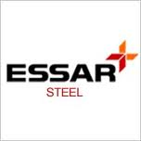








Clients

Slide 16
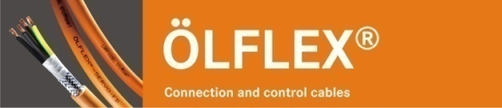
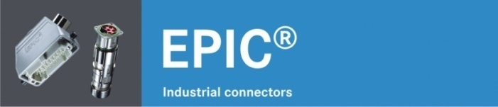
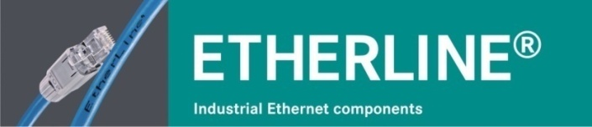
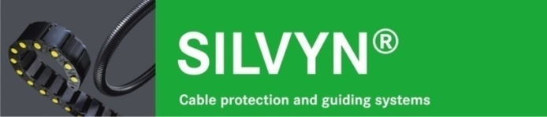
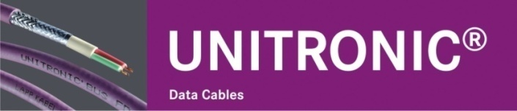
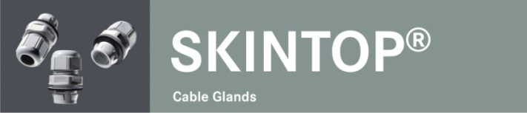
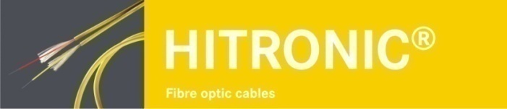
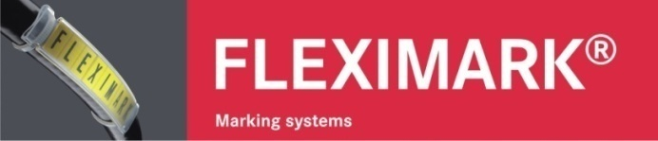
Brands

Slide 17
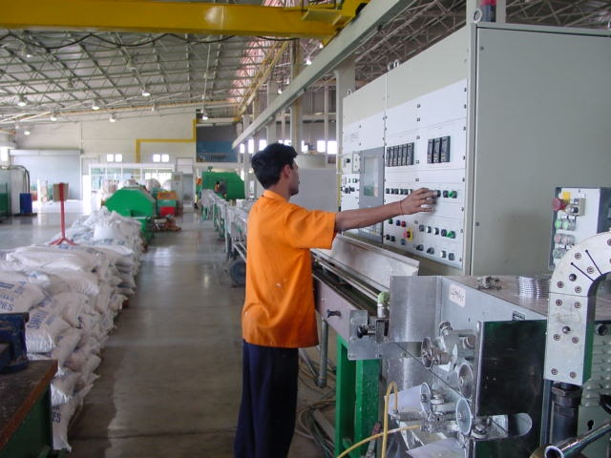
Insulation Machine – SAMP, Italy & Rosendhal, Austria

Slide 18
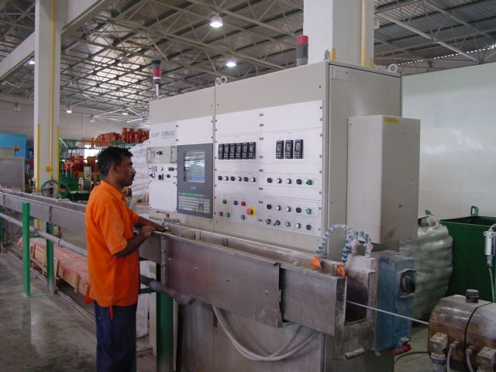
Sheathing Machine – SAMP, Italy & Mallifer, Finland

Slide 19
Where is Lapp Different from Others ???

Slide 20
Where is Lapp Different from Others ???
Management Philosophy
Raw Material
Processes

Slide 21
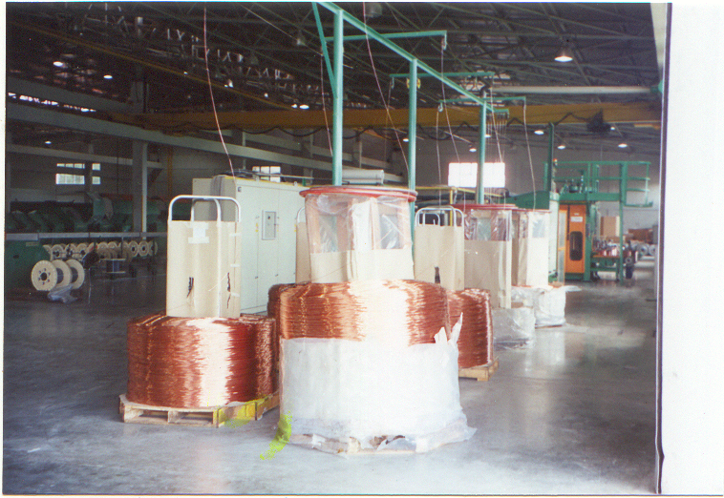
1.8 sq mm imported copper rods

Slide 22
Superior
Raw Material
Copper
Benefits
Lapp Others Benefits
Type Of Oxygen Free High Electrolytic Tough
Copper Conductivity Copper (OFHC) Pitch (ETP)
Purity 99.995% 99.95% Better Conductivity
Oxygen Content < 10ppm 200 -300 ppm Less prone to oxidation
No tinning required
Silver Content 0.0007% 0-0.0002% Better Conductivity
Conductivity 102.87%@20 Deg <100 @ 20 Deg Less voltage drop and hence watt loss
Elongation 32-37% 24-30% Less prone to wire breakage
Joints Not allowed Allowed Power Loss Change in impedence

Slide 23




Superior
Raw Material
Copper
Flexibility and Stranding
Class I Solid Conductors are not flexible
Class II 7 wire Multi Strand slightly flexible
Flexibility
Class V Flexible
Class VI Super flexible

Slide 24
Superior
Raw Material
Copper
Flexibility and Stranding
Size in mm2 7 wire Multi Strand Fine Wire Super Fine Wire Class II Class V Class VI
1.0 7 X 0.43 32 X 0.30 128 X 0.10
4.0 7 X 0.85 56 X 0.30 512 X 0.10
25 7 X 2.13 200 X 0.40 3200 X 0.10
Flexibility

Slide 25
Superior
Raw Material
Insulation
Benefits
Lapp Others Benefits
Plasticizer 24% 20% Higher Flexibility
Stabilizer 3.50% 2.50% Higher Dielectric Strength
Filler 12.50% 17.50% Lesser the filler Better The Plastic
Tensile 17N/mm2 14-16N/mm2 Sustains more
Strength pull & strength
Elongation 350% 270-325% More Elastic

Slide 26
Superior
Raw Material
Cables
Benefits (Current Carrying Capacity)
Size in mm2 Lapp Others Difference
0.5 12 6 100%
0.75 15 9 67%
1 19 14 36%
1.5 24 18 33%
2.5 32 24 33%
4 42 32 33%
6 54 42 29%
10 73 55 33%
16 98 75 31%

Slide 27
Superior
Raw Material
Cables
Air Circuit Breakers……800A/2500A/3200A…..
Fuse Links ……….6A/25A/63A……
MCCBs…….63A/100A……800A
Power Contactors……….9A………..630A……..
…. Then WHY not wires & cables ????

Slide 28
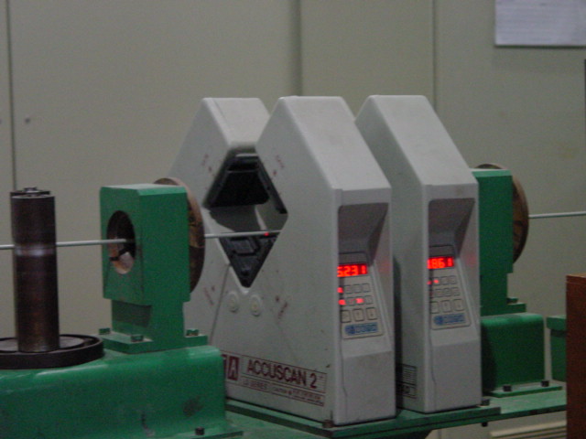
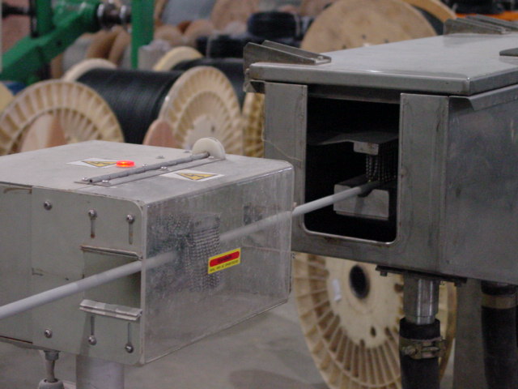
Superior
Processes
On-Line Q.C.
Outer Diameter testing
Every mm of cable gets tested for outer diameter
Spark Test
Every mm of cable gets tested for insulation failure

Slide 29
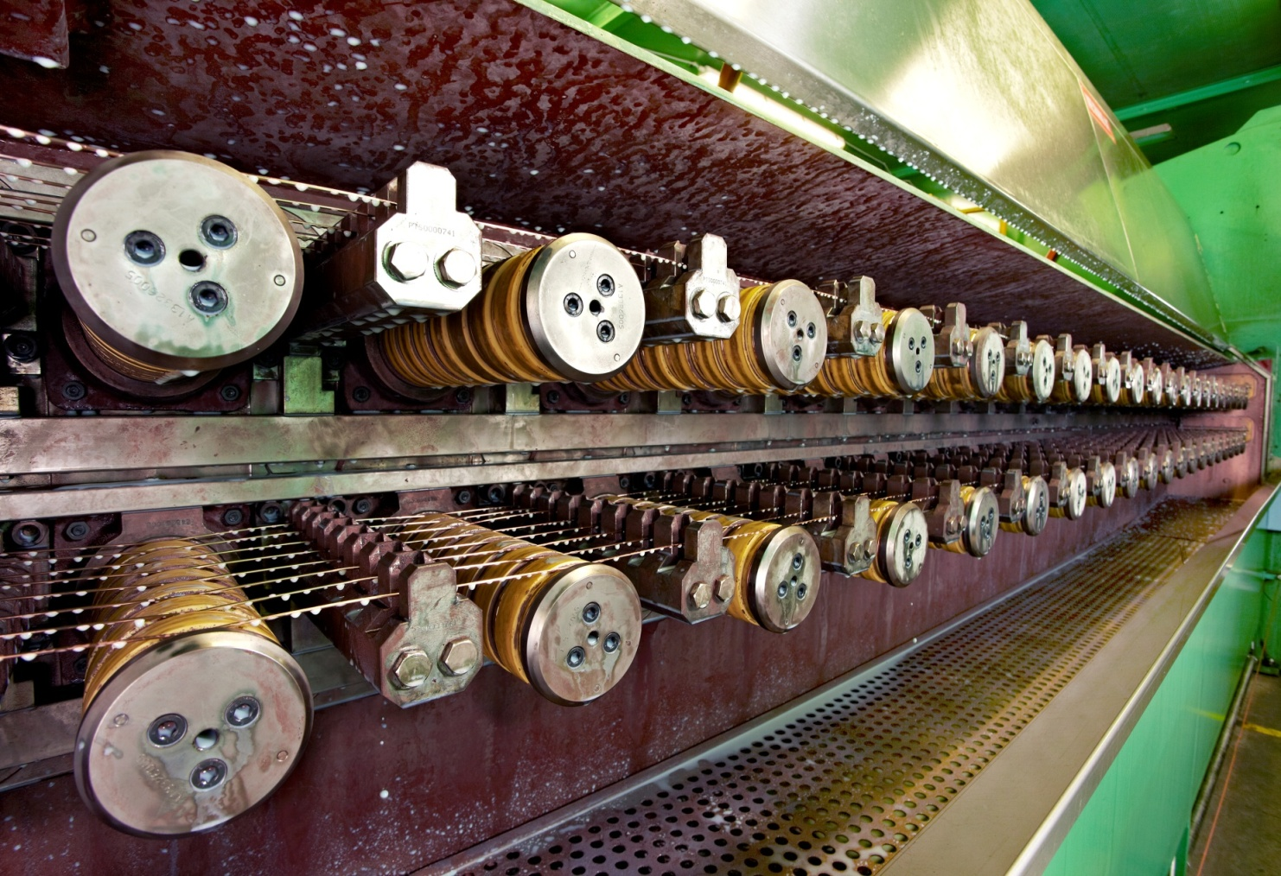
Superior
Processes
Production
Wire Drawing & Annelaing
Wire drawing (online annealing) using cold drawing process is less prone to oxidation and scaling

Slide 30

Superior
Processes
SY Cables
ÖLFLEX CLASSIC SY
Steel Braided Cables for Mechanical Protection
Also called Flexible Armoured cables

Slide 31
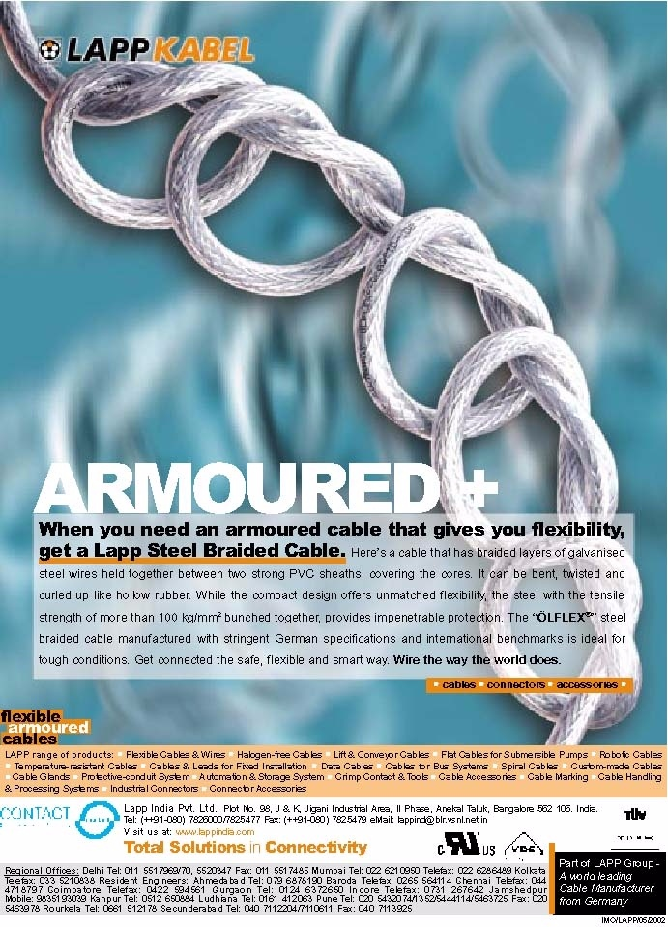
SY Cables

Slide 32
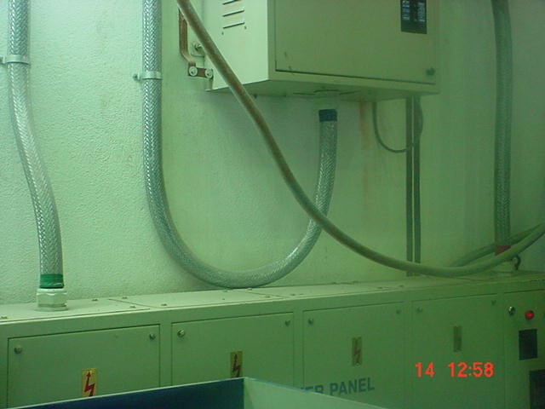
Superior
Processes
SY Cables
Flexible Armoured cables or SY Cables

Slide 33
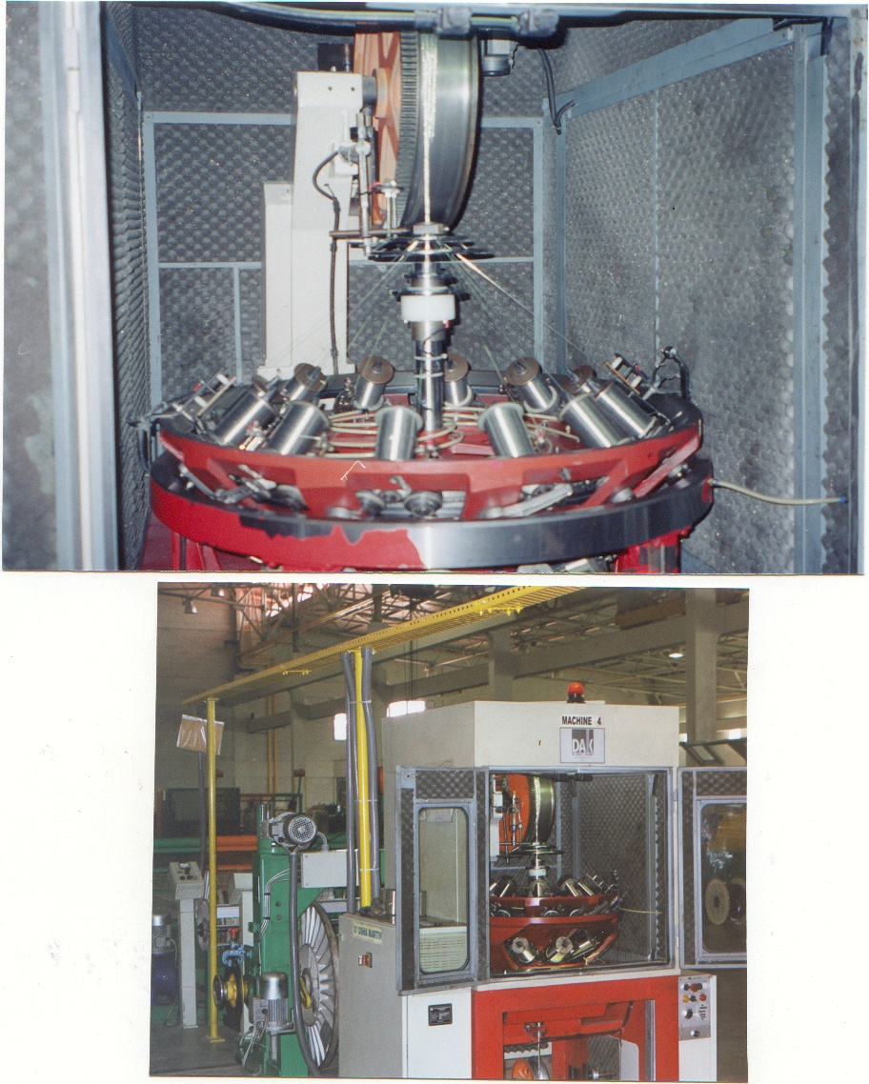
Superior
Processes
SY Cables
Flexible Armoured cables or SY Cables

Slide 34
Superior
Process
SY Cables
Benefits
Lapp SY Armoured Benefits
(Flexible Armoured)
Overall Diameter Reduced Increased More space in trays
Bending Radius 6 X Cable OD 12 X Cable OD Less cable required
Storage Space Less More Savings
Flexibility Highly Flexible Rigid Easy to Install
Cable Laying Easy Difficult Laying is faster
Cable Laying Cost Less More Savings
Cable Weight Less More Less stress on structure
Transportation Cost Less More Savings
Tensile Strength 100-146. Kg/mm2 30 -50 kg/mm2 Increased Safety
Elongation 15% 6% Less Breakages
Water Seepage Less More Longer life
Below Armour Less failure

Slide 35

Creating Connections

